Slide 1
Joint emitter and mode clustering
from mixed PDW streams
Markus Johnson Swegmark
Supervisors: Alexander Karlsson, Elin Ohlman (Saab) · Saikat Chatterjee (KTH)
Internal briefing · Saab · KTH master's thesis · Markus Johnson Swegmark
1 / 19
Notes:
Internal walkthrough, not a defence. Data and the two attention tricks first.

Slide 2
Introduction and terminology
Electronic Support Measures (ESM)
Passively detect, intercept, and analyze electromagnetic signals.
Pulse Descriptor Word (PDW)
A discrete record of a single pulse's measured parameters.
Time of arrival (TOA)
Amplitude (A)
Carrier frequency (Frequency)
Angle of arrival (AOA)
Pulse width (PW)
Converted to a Euclidean direction: three components, not the raw angles.
Internal briefing · Saab · KTH master's thesis · Markus Johnson Swegmark
2 / 19

Slide 3
Problem
In a typical ESM chain, mode recognition runs only after deinterleaving.
RF environment → detection → PDW generation → preprocessing → deinterleaving → emitter identification → mode classification → tracking
• The mode stage then sees only the predicted pulse train. A wrong assignment is passed on as a hard decision, and pulses from the other emitters are no longer in view.
• Emitter identities are local to the recording, so deinterleaving is already clustering. Clustering modes, rather than classifying them from a fixed catalogue, is what would stay open to modulations that were not in training. That split was not run.
Hypothesis
• One encoder can recover both partitions from the mixed window, instead of deinterleaving first and recognizing modes on the predicted trains.
Internal briefing · Saab · KTH master's thesis · Markus Johnson Swegmark
3 / 19
Notes:
Deinterleaving drops the other pulses before the mode stage, and the errors are hard assignments. Open-set is about new modes, not new emitters, and that experiment was not run.

Slide 4
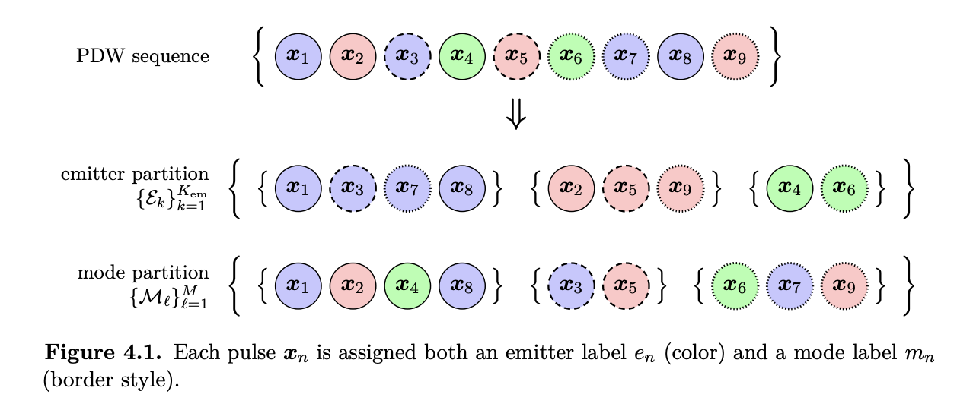
One mixed stream, two partitions
Every pulse carries two labels. They are not the same grouping, and a classical chain recovers them in sequence.
Emitter · deinterleaving
Mode · operating schedule
• The physical source. Its identifier is unique only inside the recording, so it cannot be a global class.
• Several emitters are interleaved in one stream. Separating them is deinterleaving.
• At inference the output is a cluster of embeddings, one partition per window.
• The operating mode, drawn from a catalogue of 19 types shared across recordings.
• The same mode can sit on several emitters, and one emitter can switch mode inside the window.
• At inference this is also a cluster. The catalogue supervises training. There is no softmax at test time.
Internal briefing · Saab · KTH master's thesis · Markus Johnson Swegmark
4 / 19
Notes:
Both partitions come from the mixed list. Emitter ids do not transfer across recordings. Mode labels do. Clustering at test time is deliberate, and held-out modes were not scored.

Slide 5
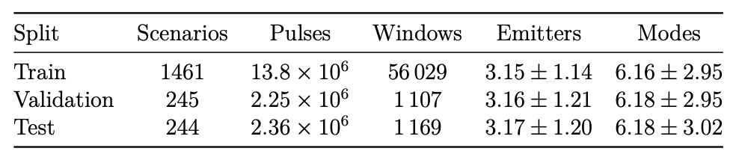
Data
• Synthetic recordings from the scenario simulator. Each pulse has a recording-local emitter identity and a mode from a catalogue of 19 types.
• 1,950 scenarios: 1,461 train, 245 validation, 244 test. No window contains more than 7 emitters. The test split is the one that contains all 19 modes.
• The encoder sees windows of 2,000 pulses. Training windows overlap (stride 200). The 1,169 test windows do not.
Split | Scenarios | Pulses | Windows | Emitters | Modes
Train | 1,461 | 13.8 million | 56,029 | 3.15 ± 1.14 | 6.16 ± 2.95
Validation | 245 | 2.25 million | 1,107 | 3.16 ± 1.21 | 6.18 ± 2.95
Test | 244 | 2.36 million | 1,169 | 3.17 ± 1.20 | 6.18 ± 3.02
Each pulse is counted once. Training windows overlap, so the large window count is reuse, not more data. Emitter and mode columns are the mean ± standard deviation of distinct labels in a window.
Internal briefing · Saab · KTH master's thesis · Markus Johnson Swegmark
5 / 19
Notes:
Do not say 2,000 scenarios or at most 10 emitters. The corpus is 1,950 scenarios, and the busiest window has 7 emitters. Test is 1,169 non-overlapping windows.

Slide 6
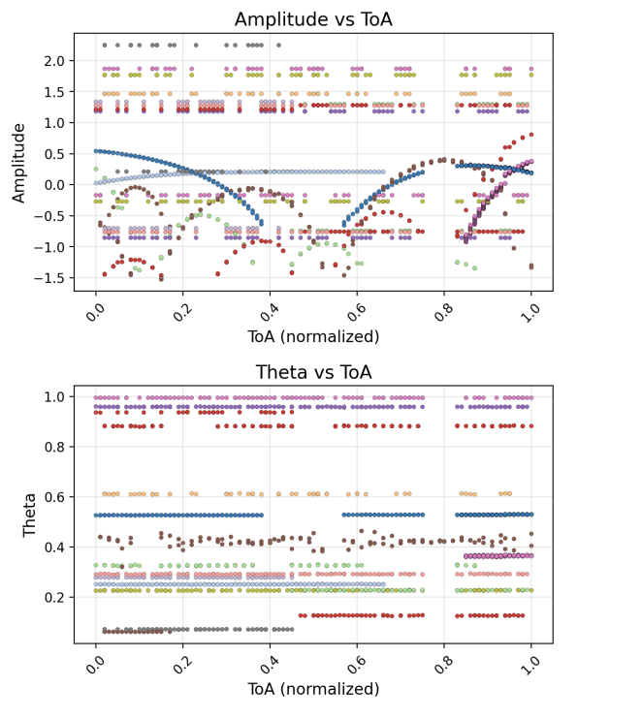
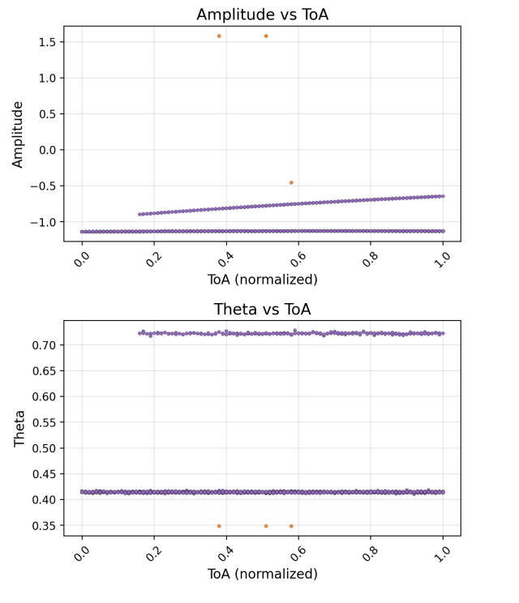
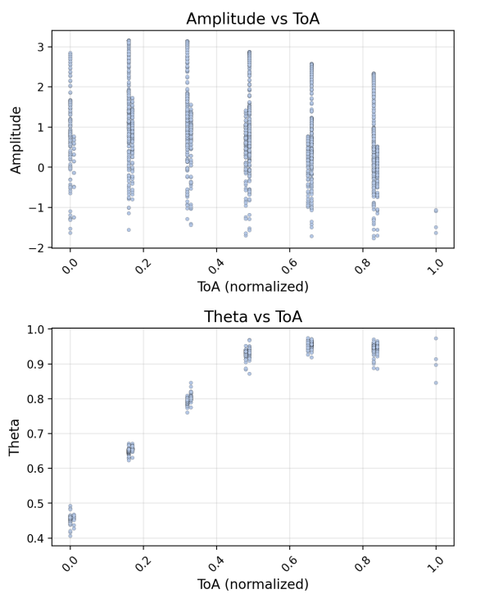
Hard windows
A crowded test window
These are the measured features, not the learned embeddings. Color is a ground-truth label.
• Crowded emitters. Frequency and pulse width are shared across platforms. This is where joint standard attention still drops some emitter windows.
• Imbalance. One test window is a 3 / 1,997 pulse split. A recovered train of three pulses is a weak input to any later mode stage.
• Scanning. One mode whose amplitude and incidence drift inside the window. That failure is not the emitter tail.
• A crowded mode mixture is a separate window from the crowded emitter mixture.
Internal briefing · Saab · KTH master's thesis · Markus Johnson Swegmark
6 / 19
Notes:
Left plot is one crowded window of input features. Then name the other cases: the 3/1997 split, a scanning mode, and a crowded mode mixture. Do not call the scanning window sparse.

Slide 7
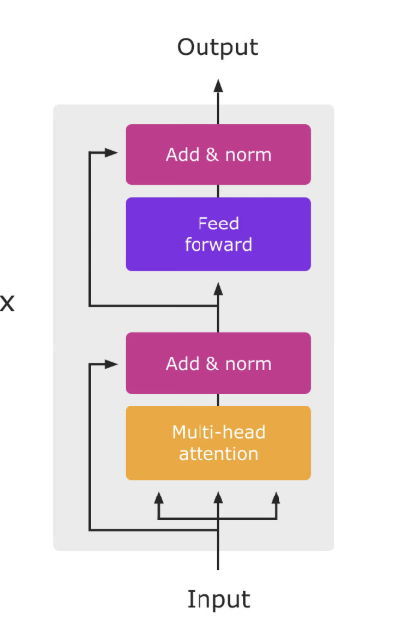
Encoder
• Input: 2,000 pulses by 7 features. Standardized carrier frequency, pulse width, and log-amplitude; window-local time of arrival; three Euclidean components of angle of arrival.
• A linear map lifts each pulse to width 256. A shared trunk of 4 layers, 8 heads, and feed-forward width 2,048 is followed by two branches of the same size.
• Each branch projects from 256 to 64 dimensions and L2-normalizes. DBSCAN runs on those 64-dimensional embeddings. The width-256 states are not the clustering space.
• 16.1 million parameters, the same count for every attention variant.
• Attention is quadratic in the window length, which is why a recording is cut into windows. Standard attention has no notion of order. The following slides put time into the attention product.
Internal briefing · Saab · KTH master's thesis · Markus Johnson Swegmark
7 / 19
Notes:
Do not say the embeddings are 256-dimensional. Hidden width is 256. The vectors that are clustered are 64-dimensional. Standard attention does not encode order; that is the point of the next slides.

Slide 8
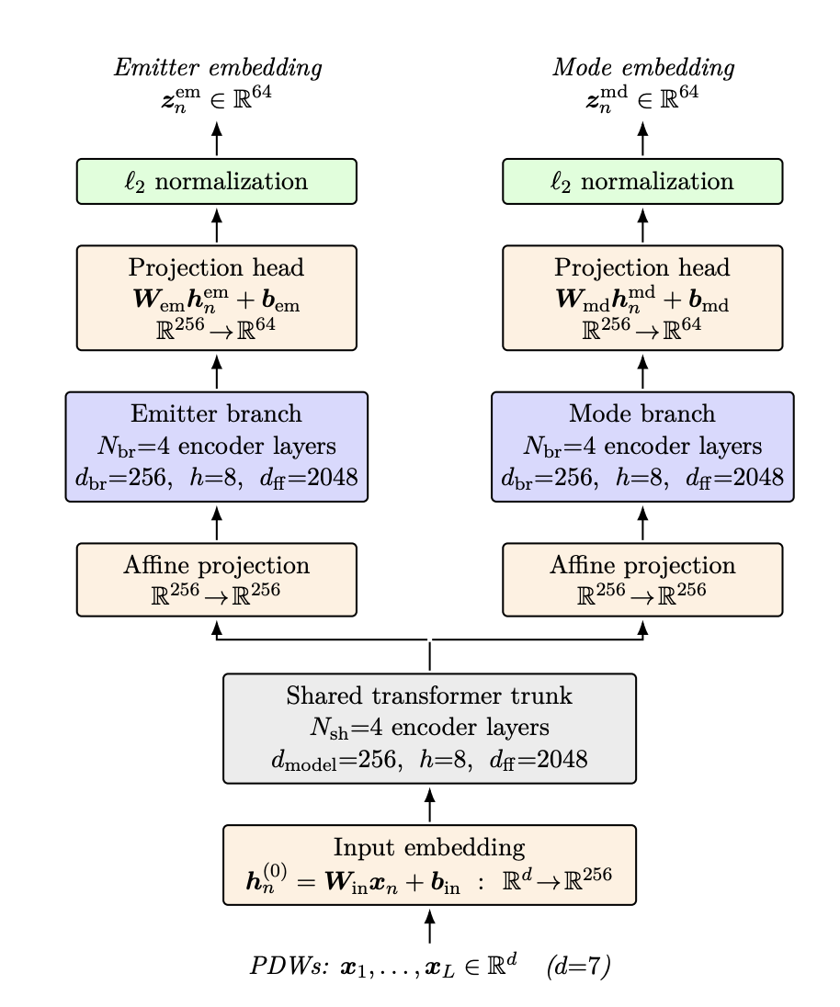
Shared trunk, two heads, two positive sets
Trunk and both branches: 4 layers, width 256, 8 heads.
Each branch projects 256 → 64, then L2-normalizes.
16.1 million parameters.
DBSCAN clusters each branch at inference.
Training does not run DBSCAN. The loss uses the embeddings.
Internal briefing · Saab · KTH master's thesis · Markus Johnson Swegmark
8 / 19
Notes:
The two losses can pull the shared trunk in different directions. The unused branch of a single-task run is cut out of the backward pass. Do not describe it as a different architecture.

Slide 9
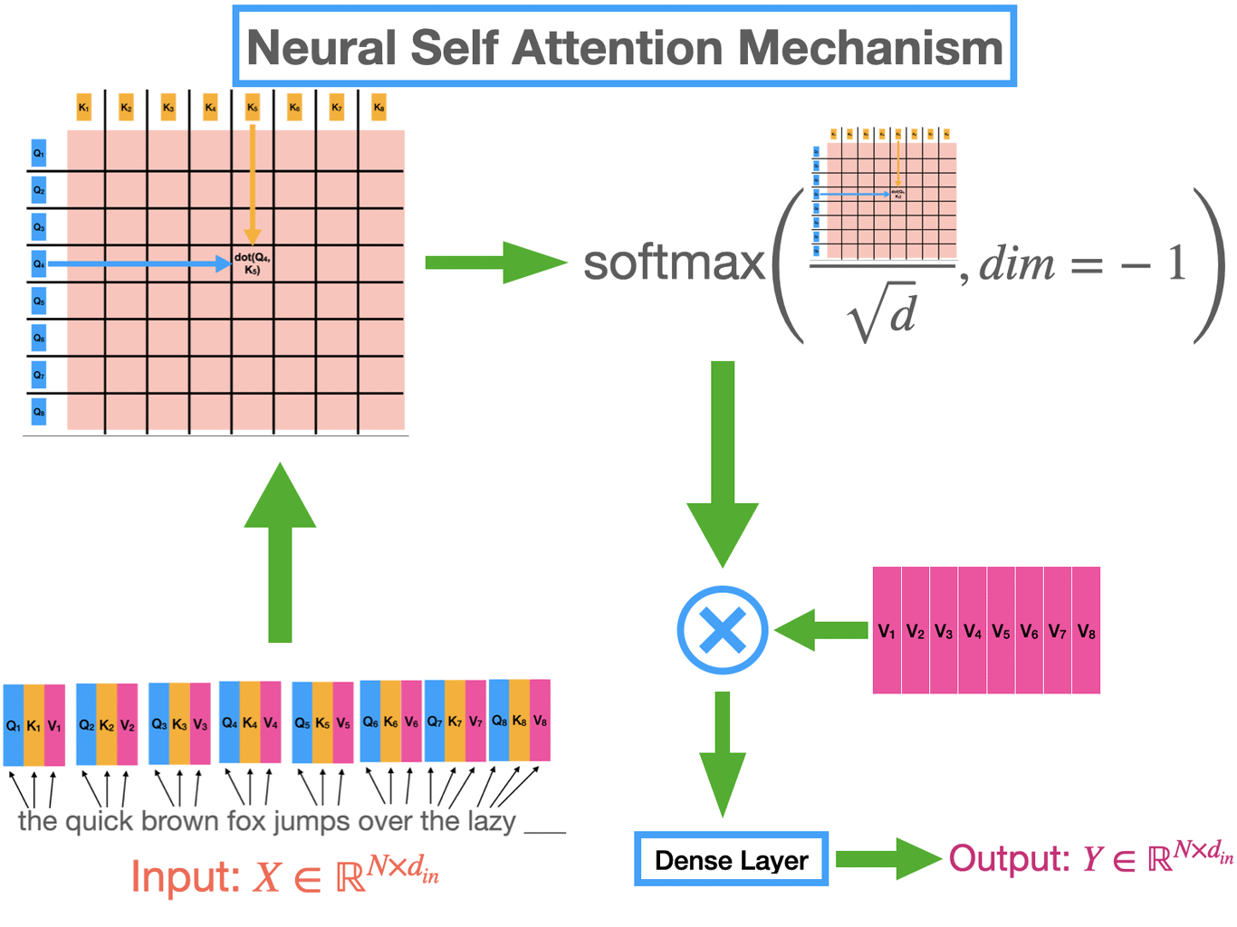
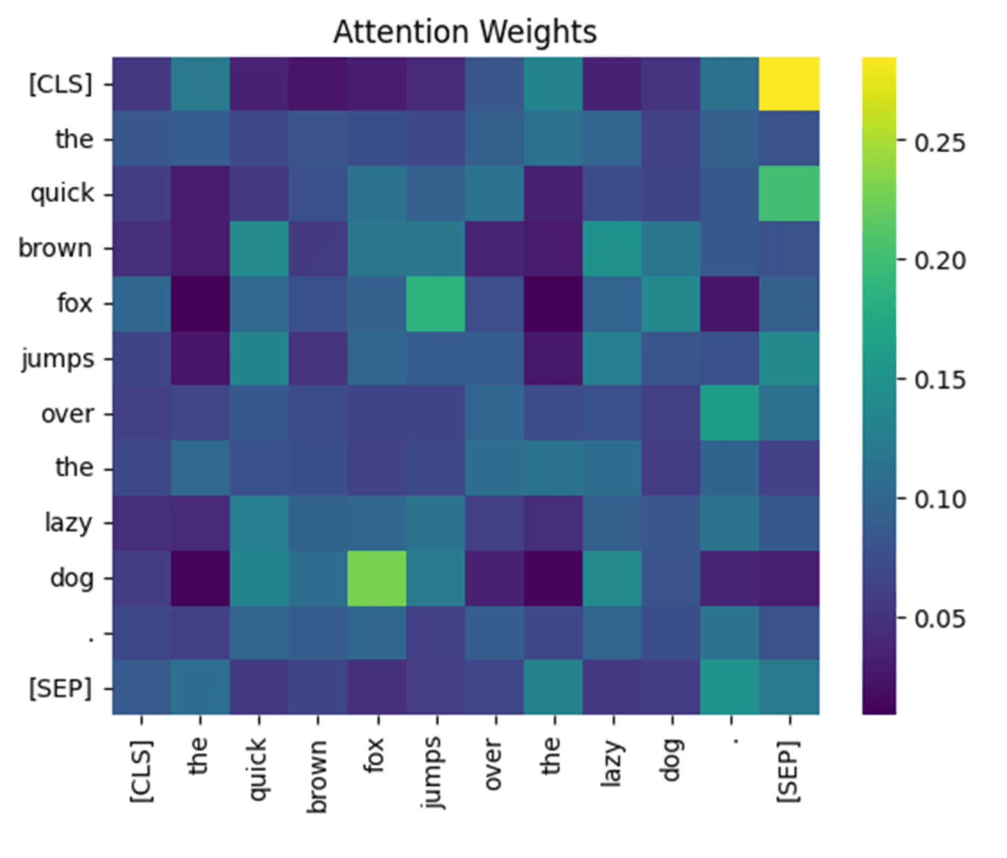
Attention
• Each head scores every pair of pulses in the window. The score is a dot product of a query and a key, passed through a softmax.
• The head then mixes values with those weights. With no mask, every pulse can attend to every other pulse in the window.
• Nothing in that product knows the time gap between two pulses, unless time is put there on purpose. Time of arrival is otherwise only one of the seven input features.
• Two ways to put it there follow. Rotate the query and the key by time of arrival, or subtract a penalty built from the time and incidence gaps.
Internal briefing · Saab · KTH master's thesis · Markus Johnson Swegmark
9 / 19
Notes:
No diagram on this slide. Attention is a pairwise score. The next slide is the two ways time enters that score. RoPE is cheap. The bias is an explicit matrix.

Slide 10
Two ways to put positional encodings into attention
Rotary positional encodings
Physical bias
Rotate queries and keys by window-local time of arrival.
Absolute gaps in time of arrival and in incidence.
Only the time gap enters the dot product.
A learned scalar per head is subtracted from the logits.
Each plane of a head rotates at its own frequency.
A negative scalar rewards a difference instead of penalizing it.
No extra weights. Forward pass 2.5 ms, against 1.6 ms.
Forward pass 32 ms. The L×L map is stored explicitly.
Pulses are not equally spaced, so time of arrival replaces the token index.
Same shape as attention, but harder to skip. RoPE-TOA is the cheap version.
Internal briefing · Saab · KTH master's thesis · Markus Johnson Swegmark
10 / 19
Notes:
Give both mechanisms in one pass. RoPE forward pass is 2.5 ms against 1.6 ms. Bias is 32 ms. Do not say the practical cost is the same. Stacking them is worse, and that result is two slides on.

Slide 11
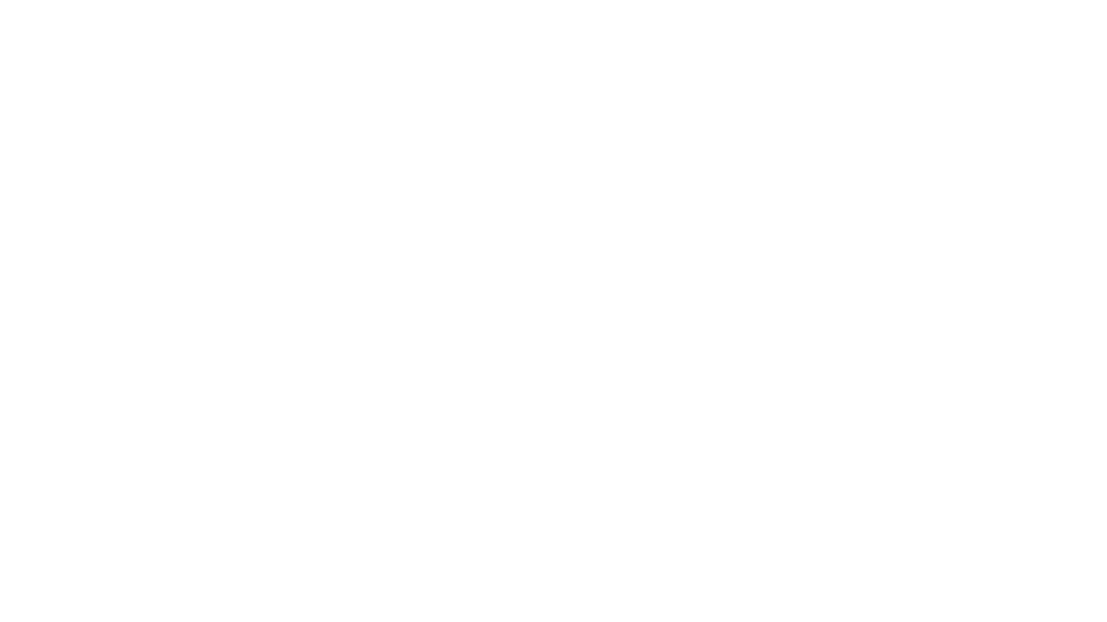
What was trained
• Vanilla. Standard self-attention. Time of arrival is only an input feature.
• RoPE-TOA. Queries and keys are rotated by window-local time of arrival, on the trunk and on both branches.
• RoPE-az. The deinterleaving branch is rotated by planar incidence instead. Incidence is already in the token, so this restates a cue the model has.
• Bias. Pairwise absolute gaps in time and incidence, scaled by a learned scalar per head and subtracted from the logits.
• RoPE-TOA+Bias. Both mechanisms at once, with the same training setup as the other neural runs. The gains do not add.
Internal briefing · Saab · KTH master's thesis · Markus Johnson Swegmark
11 / 19
Notes:
Five joint models. RoPE-az is incidence rotation on the deinterleaving branch, not a second time encoding. Say up front that stacking is a negative result, then show the numbers.

Slide 12
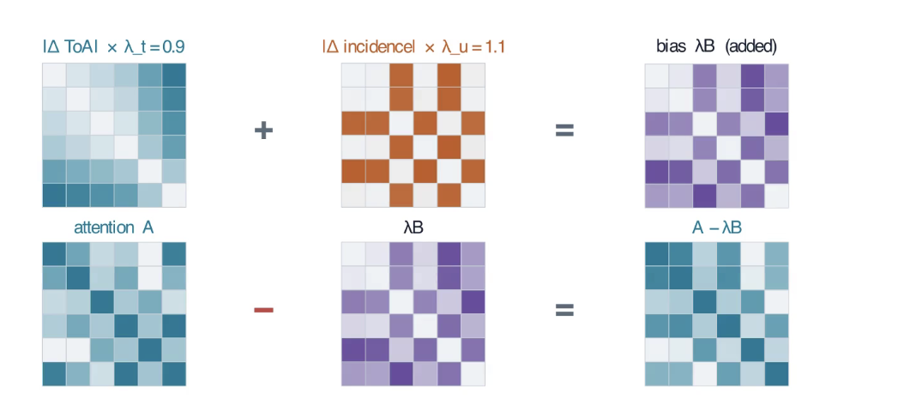
What the bias costs
• Every neural model has 16,081,536 parameters. RoPE adds none. The bias adds a few scalars per head.
• Encoder time per test window: Vanilla 1.6 ms, RoPE-TOA 2.5 ms, RoPE-az 3.1 ms, Bias 32 ms, both together 30 ms.
• DBSCAN on the two branches is about 55 ms for every model. With Vanilla or RoPE, clustering is the cost. With the bias, the forward pass is no longer negligible.
• One bias map, 8 heads by 2,000 by 2,000, is about 128 MB in 32-bit floats. Across twelve layers that storage is hard to fuse away.
• A cache can skip rebuilding the maps. It does not skip subtracting them from the logits, which is still quadratic in the window length.
Internal briefing · Saab · KTH master's thesis · Markus Johnson Swegmark
12 / 19
Notes:
Saab will ask about cost. Clustering is ~55 ms either way. The bias shows up in the forward pass: 32 ms against 1.6 ms. A cache removes the rebuild, not the subtraction.

Slide 13
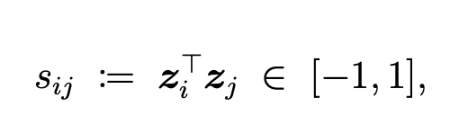
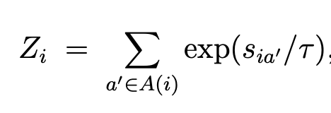
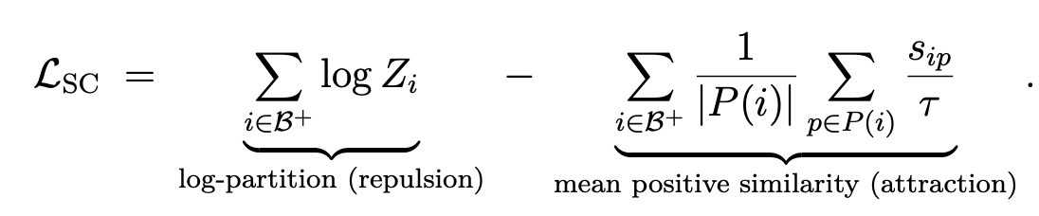
Loss
• Supervised contrastive loss on the L2-normalized embeddings. The score between two pulses is their dot product.
• Pulses that share a label are pulled together. Pulses that do not are pushed apart. Both branches use that same formula.
• Emitter positives are other pulses in the same window with the same emitter. Those identities are not shared across recordings.
• Mode positives are pulses with the same catalogue mode, including pulses from other windows in the batch. Mode labels are global.
• The joint loss is the unweighted sum of the two terms. No relative weight was trained.
Internal briefing · Saab · KTH master's thesis · Markus Johnson Swegmark
13 / 19
Notes:
Same loss, different positive set. Emitter positives stay inside the window. Mode positives can come from anywhere in the batch. The sum is unweighted, which is one candidate for the Vanilla emitter tax.

Slide 14
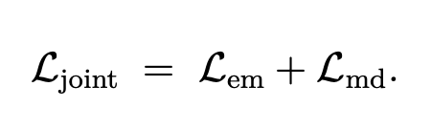
Joint and single-task training
• Joint training adds the emitter loss and the mode loss, and back-propagates both through the shared trunk.
• A single-task run keeps the same two-branch network and drops one loss. The unused branch is cut out of the backward pass and is not scored.
• That is not a separate single-stack transformer. The trunk is still shared. It only receives gradient from the active loss.
• Emitter-only runs exist for Vanilla, RoPE-TOA, and the bias. A mode-only run exists for Vanilla. Mode-only RoPE and Bias were not trained.
• Not run: deinterleave with an emitter-only model, then cluster or classify modes on each recovered train. That is the classical order.
Internal briefing · Saab · KTH master's thesis · Markus Johnson Swegmark
14 / 19
Notes:
Do not say the other branch is computed and thrown away, or that this equals a pure transformer. The inactive branch is severed from the backward pass. Mode-only RoPE and Bias do not exist in the report.

Slide 15
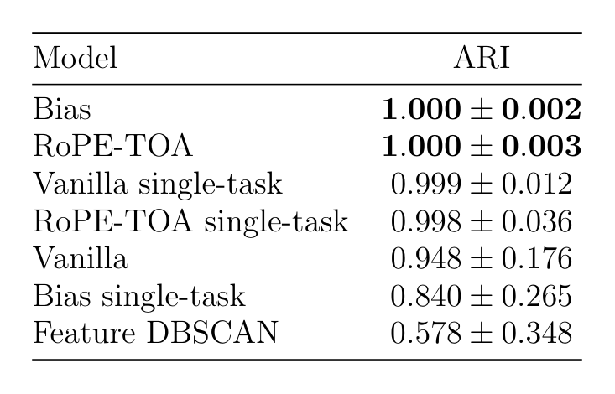
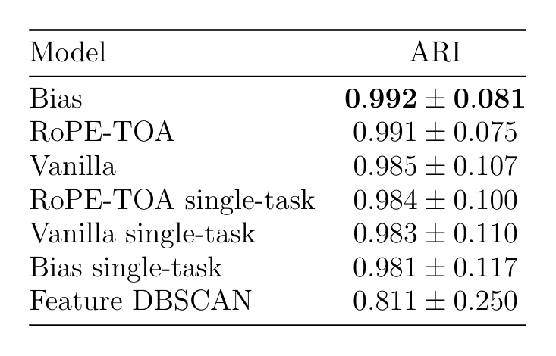
Results over 1,169 test windows
Adjusted Rand index, mean ± standard deviation across windows. Higher is better.
Deinterleaving
Mode clustering
Model | ARI
Feature DBSCAN | 0.578 ± 0.348
Joint Vanilla | 0.948 ± 0.176
Emitter-only Vanilla | 0.999 ± 0.012
Joint RoPE-TOA | 1.000 ± 0.003
Emitter-only RoPE-TOA | 0.998 ± 0.036
Joint RoPE-az | 0.973 ± 0.135
Joint Bias | 1.000 ± 0.002
Emitter-only Bias | 0.840 ± 0.265
Joint RoPE-TOA+Bias | 0.851 ± 0.255
Model | ARI
Feature DBSCAN | 0.811 ± 0.250
Joint Vanilla | 0.985 ± 0.107
Mode-only Vanilla | 0.983 ± 0.110
Joint RoPE-TOA | 0.991 ± 0.075
Joint RoPE-az | 0.983 ± 0.102
Joint Bias | 0.992 ± 0.081
Joint RoPE-TOA+Bias | 0.977 ± 0.112
Mode-only RoPE and Bias are not in the report, so they are not here. Joint RoPE-TOA and joint Bias close the emitter gap. Emitter-only Bias and stacking both mechanisms reopen it.
Internal briefing · Saab · KTH master's thesis · Markus Johnson Swegmark
15 / 19
Notes:
Walk the emitter column top to bottom. Feature DBSCAN 0.578, joint Vanilla 0.948, emitter-only Vanilla already 0.999. Joint RoPE-TOA and Bias hit 1.000. Then the two failures: emitter-only Bias 0.840 and the stack 0.851. Modes barely move, and there is no mode-only RoPE or Bias number to quote.

Slide 16
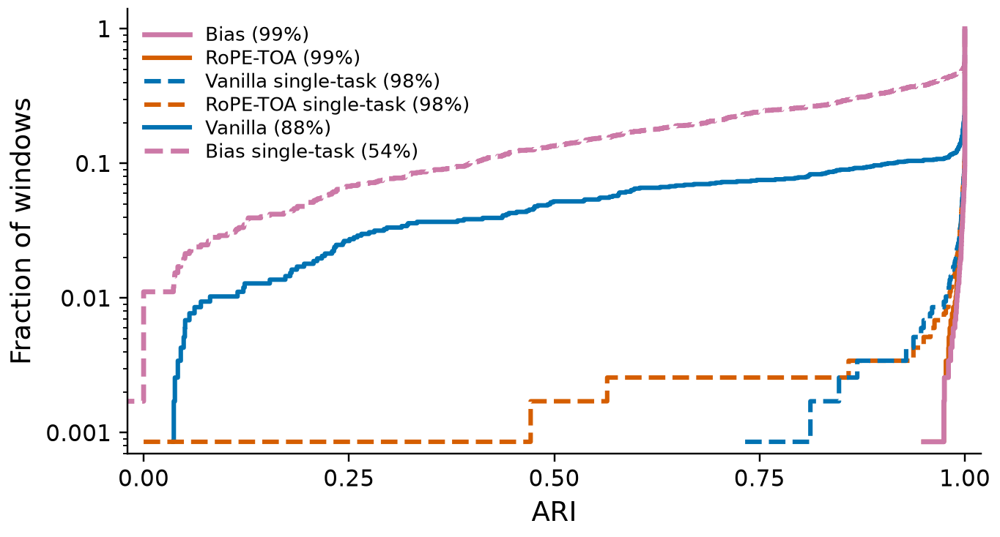
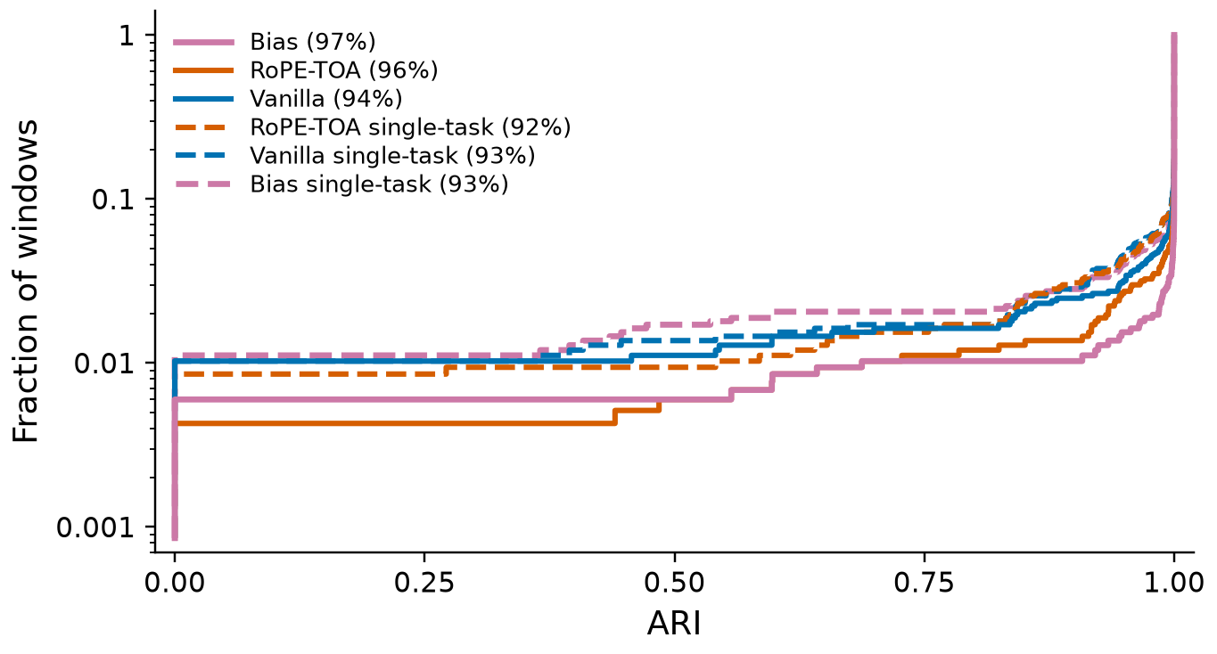
Where the errors sit
• Joint Vanilla deinterleaves most windows: 88% have emitter ARI at or above 0.99. About one window in ten falls below 0.90. Those are crowded mixtures.
• RoPE-TOA and the bias remove that tail. 99% of windows sit at or above 0.99, and none fall below 0.90.
• Emitter-only Vanilla is already at that ceiling, ARI 0.999. There is no clear winner between it and joint RoPE-TOA on deinterleaving.
• Emitter-only Bias does not get there: mean emitter ARI 0.840. The bias is not a deinterleaving-only model.
• RoPE on incidence reaches 0.973, with 4.6% of windows below 0.90, and does not match rotation by time of arrival. Stacking the two mechanisms falls to 0.851, and 31% of windows fall below 0.90.
• Modes move much less. Joint Vanilla is 0.985 against 0.983 for mode-only, and only 2.5% of its mode windows fall below 0.90.
Internal briefing · Saab · KTH master's thesis · Markus Johnson Swegmark
16 / 19
Notes:
This replaces the curves. The mean hides a tail: joint Vanilla fails on about one crowded window in ten. RoPE-TOA and Bias do not. Emitter-only Vanilla was already there. Emitter-only Bias and the stack are the negative results. Modes were never the hard task.

Slide 17
Conclusion
Deinterleaving
• Under standard attention the joint loss costs emitters: 0.948 against 0.999 for an emitter-only encoder.
• Once time is in the attention product, the joint encoder is at par. Joint RoPE-TOA and joint Bias reach 1.000. The margin over emitter-only Vanilla is too small to call a winner.
• Two variants do not work. Stacking both mechanisms scores 0.851. Training the bias for deinterleaving alone scores 0.840.
Mode clustering
• The joint model is slightly above mode-only Vanilla, already under standard attention (0.985 against 0.983), and a little higher again with RoPE-TOA or the bias.
• A mode stage on the trains of an emitter-only encoder was not scored. Held-out modulations were not scored either.
Internal briefing · Saab · KTH master's thesis · Markus Johnson Swegmark
17 / 19
Notes:
Three sentences on emitters: joint Vanilla taxes them; time in attention removes the tax; stacking and emitter-only Bias fail. On modes, slightly higher, and the fair pipeline comparison was not run. Do not say the joint model is slightly better as if there were a winner on deinterleaving.

Slide 18
Further work
• Across windows. A score covers 2,000 pulses. The same emitter in the next window is not linked. One approach is to cluster the mean embedding of each window cluster over the recording.
• A live stream. The encoder reads a whole block. A cache of keys and values would let a new pulse attend to that block without a full forward pass.
• Model size. About 16 million parameters, while most windows already sit at the ceiling. A narrower or shallower stack was not tried.
• The two losses are added with equal weight. A higher weight on the emitter term might remove the Vanilla tax without giving up the modes.
• Catalogue names. A linear head on the frozen mode embeddings would name types seen in training. Clustering would remain the decoder for types outside the catalogue.
• Not in this study: held-out modulation types, operational recordings, and a classical mode stage after deinterleaving.
Internal briefing · Saab · KTH master's thesis · Markus Johnson Swegmark
18 / 19
Notes:
Windows, streaming, capacity, the loss weight, a classification head, and the two missing evaluations: held-out modes and operational data. RoPE-TOA is the practical joint recipe if they ask what to build next. The bias does the same job and costs more.

Slide 19
Questions?
Internal briefing · Saab · KTH master's thesis · Markus Johnson Swegmark
19 / 19

